Slide 1
Jenkins
Setup and Installation

Slide 2

Set up Jenkins
The Jenkins server will be fully up and running at http://localhost:8080.

Slide 3
You can find the initial admin password as mentioned on the login page or in the console output.

Slide 4
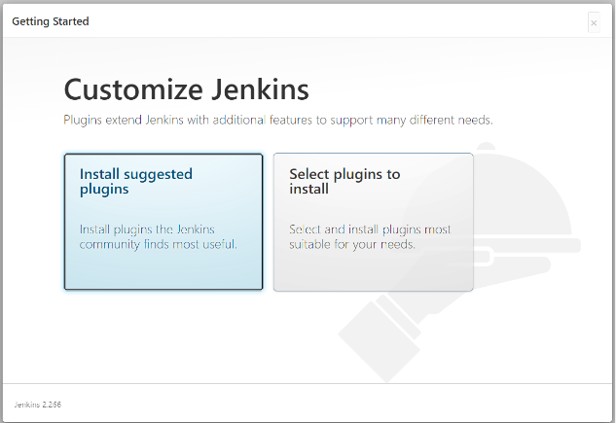
Next, we can install plugins as per our requirement. Choose ‘Install Suggested Plugins’

Slide 5
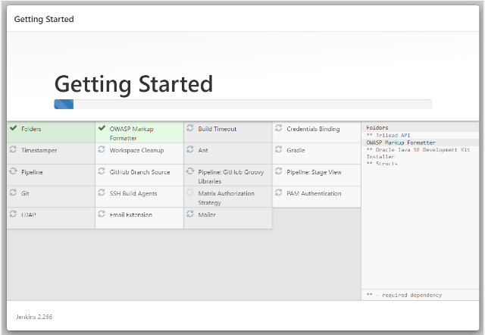
It may take some time depending upon the number of plugins you choose to install. Once the plugins are installed, you will be prompted to create a first admin user.

Slide 6
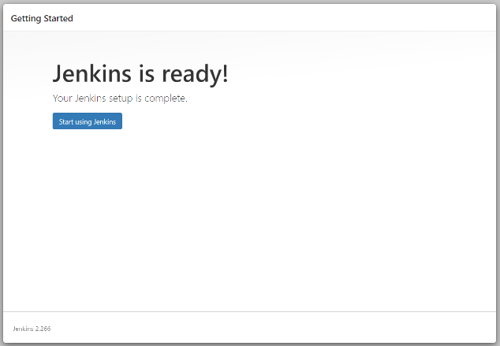
Success!!

